Slide 1
Maximum

Slide 2
Maximum . instruction
.section .data # starting with period means assembler
# instructions and not machine code
data_items:
.long 3, 67, 222, 45, 0 # array of longs, 5 x 4 bytes = 20 bytes
.section .text # where instructions live
.globl _start # tell program to start at _start
_start:
movl $0, %edi # move 0 into the index register
movl data_items(,%edi,4), %eax # load 1st byte of data
movl %eax, %ebx # 1st loop so %eax is the largest
start_loop:
cmpl $0, %eax # check to see if end of data
je loop_exit # jump if equal
incl %edi # increase index
movl data_items(,%edi,4), %eax # load next byte of data
cmpl %ebx, %eax # compare values
jle start_loop # jump back if new value is smaller
movl %eax, %ebx # save value as the largest
jmp start_loop # jump back
loop_exit:
movl $1, %eax # EAX = 1 (exit code), EBX = 222 (return value)
int $0x80 # interrupt 16

Slide 3
Maximum array
.section .data # starting with period means assembler
# instructions and not machine code
data_items:
.long 3, 67, 222, 45, 0 # array of longs, 5 x 4 bytes = 20 bytes
.section .text # where instructions live
.globl _start # tell program to start at _start
_start:
movl $0, %edi # move 0 into the index register
movl data_items(,%edi,4), %eax # load 1st byte of data
movl %eax, %ebx # 1st loop so %eax is the largest
start_loop:
cmpl $0, %eax # check to see if end of data
je loop_exit # jump if equal
incl %edi # increase index
movl data_items(,%edi,4), %eax # load next byte of data
cmpl %ebx, %eax # compare values
jle start_loop # jump back if new value is smaller
movl %eax, %ebx # save value as the largest
jmp start_loop # jump back
loop_exit:
movl $1, %eax # EAX = 1 (exit code), EBX = 222 (return value)
int $0x80 # interrupt 16

Slide 4
Maximum .text
.section .data # starting with period means assembler
# instructions and not machine code
data_items:
.long 3, 67, 222, 45, 0 # array of longs, 5 x 4 bytes = 20 bytes
.section .text # where instructions live
.globl _start # tell program to start at _start
_start:
movl $0, %edi # move 0 into the index register
movl data_items(,%edi,4), %eax # load 1st byte of data
movl %eax, %ebx # 1st loop so %eax is the largest
start_loop:
cmpl $0, %eax # check to see if end of data
je loop_exit # jump if equal
incl %edi # increase index
movl data_items(,%edi,4), %eax # load next byte of data
cmpl %ebx, %eax # compare values
jle start_loop # jump back if new value is smaller
movl %eax, %ebx # save value as the largest
jmp start_loop # jump back
loop_exit:
movl $1, %eax # EAX = 1 (exit code), EBX = 222 (return value)
int $0x80 # interrupt 16

Slide 5
Maximum .globl _start
.section .data # starting with period means assembler
# instructions and not machine code
data_items:
.long 3, 67, 222, 45, 0 # array of longs, 5 x 4 bytes = 20 bytes
.section .text # where instructions live
.globl _start # tell program to start at _start
_start:
movl $0, %edi # move 0 into the index register
movl data_items(,%edi,4), %eax # load 1st byte of data
movl %eax, %ebx # 1st loop so %eax is the largest
start_loop:
cmpl $0, %eax # check to see if end of data
je loop_exit # jump if equal
incl %edi # increase index
movl data_items(,%edi,4), %eax # load next byte of data
cmpl %ebx, %eax # compare values
jle start_loop # jump back if new value is smaller
movl %eax, %ebx # save value as the largest
jmp start_loop # jump back
loop_exit:
movl $1, %eax # EAX = 1 (exit code), EBX = 222 (return value)
int $0x80 # interrupt 16

Slide 6
Maximum i = 0
.section .data # starting with period means assembler
# instructions and not machine code
data_items:
.long 3, 67, 222, 45, 0 # array of longs, 5 x 4 bytes = 20 bytes
.section .text # where instructions live
.globl _start # tell program to start at _start
_start:
movl $0, %edi # move 0 into the index register
movl data_items(,%edi,4), %eax # load 1st byte of data
movl %eax, %ebx # 1st loop so %eax is the largest
start_loop:
cmpl $0, %eax # check to see if end of data
je loop_exit # jump if equal
incl %edi # increase index
movl data_items(,%edi,4), %eax # load next byte of data
cmpl %ebx, %eax # compare values
jle start_loop # jump back if new value is smaller
movl %eax, %ebx # save value as the largest
jmp start_loop # jump back
loop_exit:
movl $1, %eax # EAX = 1 (exit code), EBX = 222 (return value)
int $0x80 # interrupt 16
EDI = 0

Slide 7
Maximum i = 0
.section .data # starting with period means assembler
# instructions and not machine code
data_items:
.long 3, 67, 222, 45, 0 # array of longs, 5 x 4 bytes = 20 bytes
.section .text # where instructions live
.globl _start # tell program to start at _start
_start:
movl $0, %edi # move 0 into the index register
movl data_items(,%edi,4), %eax # load 1st byte of data
movl %eax, %ebx # 1st loop so %eax is the largest
start_loop:
cmpl $0, %eax # check to see if end of data
je loop_exit # jump if equal
incl %edi # increase index
movl data_items(,%edi,4), %eax # load next byte of data
cmpl %ebx, %eax # compare values
jle start_loop # jump back if new value is smaller
movl %eax, %ebx # save value as the largest
jmp start_loop # jump back
loop_exit:
movl $1, %eax # EAX = 1 (exit code), EBX = 222 (return value)
int $0x80 # interrupt 16
EDI = 0
EAX = 3

Slide 8
Maximum i = 0
.section .data # starting with period means assembler
# instructions and not machine code
data_items:
.long 3, 67, 222, 45, 0 # array of longs, 5 x 4 bytes = 20 bytes
.section .text # where instructions live
.globl _start # tell program to start at _start
_start:
movl $0, %edi # move 0 into the index register
movl data_items(,%edi,4), %eax # load 1st byte of data
movl %eax, %ebx # 1st loop so %eax is the largest
start_loop:
cmpl $0, %eax # check to see if end of data
je loop_exit # jump if equal
incl %edi # increase index
movl data_items(,%edi,4), %eax # load next byte of data
cmpl %ebx, %eax # compare values
jle start_loop # jump back if new value is smaller
movl %eax, %ebx # save value as the largest
jmp start_loop # jump back
loop_exit:
movl $1, %eax # EAX = 1 (exit code), EBX = 222 (return value)
int $0x80 # interrupt 16
EDI = 0
EAX = 3
EBX = 3

Slide 9
Maximum end?
.section .data # starting with period means assembler
# instructions and not machine code
data_items:
.long 3, 67, 222, 45, 0 # array of longs, 5 x 4 bytes = 20 bytes
.section .text # where instructions live
.globl _start # tell program to start at _start
_start:
movl $0, %edi # move 0 into the index register
movl data_items(,%edi,4), %eax # load 1st byte of data
movl %eax, %ebx # 1st loop so %eax is the largest
start_loop:
cmpl $0, %eax # check to see if end of data
je loop_exit # jump if equal
incl %edi # increase index
movl data_items(,%edi,4), %eax # load next byte of data
cmpl %ebx, %eax # compare values
jle start_loop # jump back if new value is smaller
movl %eax, %ebx # save value as the largest
jmp start_loop # jump back
loop_exit:
movl $1, %eax # EAX = 1 (exit code), EBX = 222 (return value)
int $0x80 # interrupt 16
EDI = 0
EAX = 3
EBX = 3

Slide 10
Maximum i = 1
.section .data # starting with period means assembler
# instructions and not machine code
data_items:
.long 3, 67, 222, 45, 0 # array of longs, 5 x 4 bytes = 20 bytes
.section .text # where instructions live
.globl _start # tell program to start at _start
_start:
movl $0, %edi # move 0 into the index register
movl data_items(,%edi,4), %eax # load 1st byte of data
movl %eax, %ebx # 1st loop so %eax is the largest
start_loop:
cmpl $0, %eax # check to see if end of data
je loop_exit # jump if equal
incl %edi # increase index
movl data_items(,%edi,4), %eax # load next byte of data
cmpl %ebx, %eax # compare values
jle start_loop # jump back if new value is smaller
movl %eax, %ebx # save value as the largest
jmp start_loop # jump back
loop_exit:
movl $1, %eax # EAX = 1 (exit code), EBX = 222 (return value)
int $0x80 # interrupt 16
EDI = 1
EAX = 3
EBX = 3

Slide 11
Maximum i = 1
.section .data # starting with period means assembler
# instructions and not machine code
data_items:
.long 3, 67, 222, 45, 0 # array of longs, 5 x 4 bytes = 20 bytes
.section .text # where instructions live
.globl _start # tell program to start at _start
_start:
movl $0, %edi # move 0 into the index register
movl data_items(,%edi,4), %eax # load 1st byte of data
movl %eax, %ebx # 1st loop so %eax is the largest
start_loop:
cmpl $0, %eax # check to see if end of data
je loop_exit # jump if equal
incl %edi # increase index
movl data_items(,%edi,4), %eax # load next byte of data
cmpl %ebx, %eax # compare values
jle start_loop # jump back if new value is smaller
movl %eax, %ebx # save value as the largest
jmp start_loop # jump back
loop_exit:
movl $1, %eax # EAX = 1 (exit code), EBX = 222 (return value)
int $0x80 # interrupt 16
EDI = 1
EAX = 67
EBX = 3

Slide 12
Maximum largest ? array[1]
.section .data # starting with period means assembler
# instructions and not machine code
data_items:
.long 3, 67, 222, 45, 0 # array of longs, 5 x 4 bytes = 20 bytes
.section .text # where instructions live
.globl _start # tell program to start at _start
_start:
movl $0, %edi # move 0 into the index register
movl data_items(,%edi,4), %eax # load 1st byte of data
movl %eax, %ebx # 1st loop so %eax is the largest
start_loop:
cmpl $0, %eax # check to see if end of data
je loop_exit # jump if equal
incl %edi # increase index
movl data_items(,%edi,4), %eax # load next byte of data
cmpl %ebx, %eax # compare values
jle start_loop # jump back if new value is smaller
movl %eax, %ebx # save value as the largest
jmp start_loop # jump back
loop_exit:
movl $1, %eax # EAX = 1 (exit code), EBX = 222 (return value)
int $0x80 # interrupt 16
EDI = 1
EAX = 67
EBX = 3

Slide 13
Maximum largest = array[1]
.section .data # starting with period means assembler
# instructions and not machine code
data_items:
.long 3, 67, 222, 45, 0 # array of longs, 5 x 4 bytes = 20 bytes
.section .text # where instructions live
.globl _start # tell program to start at _start
_start:
movl $0, %edi # move 0 into the index register
movl data_items(,%edi,4), %eax # load 1st byte of data
movl %eax, %ebx # 1st loop so %eax is the largest
start_loop:
cmpl $0, %eax # check to see if end of data
je loop_exit # jump if equal
incl %edi # increase index
movl data_items(,%edi,4), %eax # load next byte of data
cmpl %ebx, %eax # compare values
jle start_loop # jump back if new value is smaller
movl %eax, %ebx # save value as the largest
jmp start_loop # jump back
loop_exit:
movl $1, %eax # EAX = 1 (exit code), EBX = 222 (return value)
int $0x80 # interrupt 16
EDI = 1
EAX = 67
EBX = 67

Slide 14
Maximum restart loop
.section .data # starting with period means assembler
# instructions and not machine code
data_items:
.long 3, 67, 222, 45, 0 # array of longs, 5 x 4 bytes = 20 bytes
.section .text # where instructions live
.globl _start # tell program to start at _start
_start:
movl $0, %edi # move 0 into the index register
movl data_items(,%edi,4), %eax # load 1st byte of data
movl %eax, %ebx # 1st loop so %eax is the largest
start_loop:
cmpl $0, %eax # check to see if end of data
je loop_exit # jump if equal
incl %edi # increase index
movl data_items(,%edi,4), %eax # load next byte of data
cmpl %ebx, %eax # compare values
jle start_loop # jump back if new value is smaller
movl %eax, %ebx # save value as the largest
jmp start_loop # jump back
loop_exit:
movl $1, %eax # EAX = 1 (exit code), EBX = 222 (return value)
int $0x80 # interrupt 16
EDI = 1
EAX = 67
EBX = 67

Slide 15
Maximum end?
.section .data # starting with period means assembler
# instructions and not machine code
data_items:
.long 3, 67, 222, 45, 0 # array of longs, 5 x 4 bytes = 20 bytes
.section .text # where instructions live
.globl _start # tell program to start at _start
_start:
movl $0, %edi # move 0 into the index register
movl data_items(,%edi,4), %eax # load 1st byte of data
movl %eax, %ebx # 1st loop so %eax is the largest
start_loop:
cmpl $0, %eax # check to see if end of data
je loop_exit # jump if equal
incl %edi # increase index
movl data_items(,%edi,4), %eax # load next byte of data
cmpl %ebx, %eax # compare values
jle start_loop # jump back if new value is smaller
movl %eax, %ebx # save value as the largest
jmp start_loop # jump back
loop_exit:
movl $1, %eax # EAX = 1 (exit code), EBX = 222 (return value)
int $0x80 # interrupt 16
EDI = 1
EAX = 67
EBX = 67

Slide 16
Maximum i = 2
.section .data # starting with period means assembler
# instructions and not machine code
data_items:
.long 3, 67, 222, 45, 0 # array of longs, 5 x 4 bytes = 20 bytes
.section .text # where instructions live
.globl _start # tell program to start at _start
_start:
movl $0, %edi # move 0 into the index register
movl data_items(,%edi,4), %eax # load 1st byte of data
movl %eax, %ebx # 1st loop so %eax is the largest
start_loop:
cmpl $0, %eax # check to see if end of data
je loop_exit # jump if equal
incl %edi # increase index
movl data_items(,%edi,4), %eax # load next byte of data
cmpl %ebx, %eax # compare values
jle start_loop # jump back if new value is smaller
movl %eax, %ebx # save value as the largest
jmp start_loop # jump back
loop_exit:
movl $1, %eax # EAX = 1 (exit code), EBX = 222 (return value)
int $0x80 # interrupt 16
EDI = 2
EAX = 67
EBX = 67

Slide 17
Maximum i = 2
.section .data # starting with period means assembler
# instructions and not machine code
data_items:
.long 3, 67, 222, 45, 0 # array of longs, 5 x 4 bytes = 20 bytes
.section .text # where instructions live
.globl _start # tell program to start at _start
_start:
movl $0, %edi # move 0 into the index register
movl data_items(,%edi,4), %eax # load 1st byte of data
movl %eax, %ebx # 1st loop so %eax is the largest
start_loop:
cmpl $0, %eax # check to see if end of data
je loop_exit # jump if equal
incl %edi # increase index
movl data_items(,%edi,4), %eax # load next byte of data
cmpl %ebx, %eax # compare values
jle start_loop # jump back if new value is smaller
movl %eax, %ebx # save value as the largest
jmp start_loop # jump back
loop_exit:
movl $1, %eax # EAX = 1 (exit code), EBX = 222 (return value)
int $0x80 # interrupt 16
EDI = 2
EAX = 222
EBX = 67

Slide 18
Maximum largest ? array[2]
.section .data # starting with period means assembler
# instructions and not machine code
data_items:
.long 3, 67, 222, 45, 0 # array of longs, 5 x 4 bytes = 20 bytes
.section .text # where instructions live
.globl _start # tell program to start at _start
_start:
movl $0, %edi # move 0 into the index register
movl data_items(,%edi,4), %eax # load 1st byte of data
movl %eax, %ebx # 1st loop so %eax is the largest
start_loop:
cmpl $0, %eax # check to see if end of data
je loop_exit # jump if equal
incl %edi # increase index
movl data_items(,%edi,4), %eax # load next byte of data
cmpl %ebx, %eax # compare values
jle start_loop # jump back if new value is smaller
movl %eax, %ebx # save value as the largest
jmp start_loop # jump back
loop_exit:
movl $1, %eax # EAX = 1 (exit code), EBX = 222 (return value)
int $0x80 # interrupt 16
EDI = 2
EAX = 222
EBX = 67

Slide 19
Maximum largest = array[2]
.section .data # starting with period means assembler
# instructions and not machine code
data_items:
.long 3, 67, 222, 45, 0 # array of longs, 5 x 4 bytes = 20 bytes
.section .text # where instructions live
.globl _start # tell program to start at _start
_start:
movl $0, %edi # move 0 into the index register
movl data_items(,%edi,4), %eax # load 1st byte of data
movl %eax, %ebx # 1st loop so %eax is the largest
start_loop:
cmpl $0, %eax # check to see if end of data
je loop_exit # jump if equal
incl %edi # increase index
movl data_items(,%edi,4), %eax # load next byte of data
cmpl %ebx, %eax # compare values
jle start_loop # jump back if new value is smaller
movl %eax, %ebx # save value as the largest
jmp start_loop # jump back
loop_exit:
movl $1, %eax # EAX = 1 (exit code), EBX = 222 (return value)
int $0x80 # interrupt 16.se
EDI = 2
EAX = 222
EBX = 222

Slide 20
Maximum restart loop
.section .data # starting with period means assembler
# instructions and not machine code
data_items:
.long 3, 67, 222, 45, 0 # array of longs, 5 x 4 bytes = 20 bytes
.section .text # where instructions live
.globl _start # tell program to start at _start
_start:
movl $0, %edi # move 0 into the index register
movl data_items(,%edi,4), %eax # load 1st byte of data
movl %eax, %ebx # 1st loop so %eax is the largest
start_loop:
cmpl $0, %eax # check to see if end of data
je loop_exit # jump if equal
incl %edi # increase index
movl data_items(,%edi,4), %eax # load next byte of data
cmpl %ebx, %eax # compare values
jle start_loop # jump back if new value is smaller
movl %eax, %ebx # save value as the largest
jmp start_loop # jump back
loop_exit:
movl $1, %eax # EAX = 1 (exit code), EBX = 222 (return value)
int $0x80 # interrupt 16
EDI = 2
EAX = 222
EBX = 222

Slide 21
Maximum end?
.section .data # starting with period means assembler
# instructions and not machine code
data_items:
.long 3, 67, 222, 45, 0 # array of longs, 5 x 4 bytes = 20 bytes
.section .text # where instructions live
.globl _start # tell program to start at _start
_start:
movl $0, %edi # move 0 into the index register
movl data_items(,%edi,4), %eax # load 1st byte of data
movl %eax, %ebx # 1st loop so %eax is the largest
start_loop:
cmpl $0, %eax # check to see if end of data
je loop_exit # jump if equal
incl %edi # increase index
movl data_items(,%edi,4), %eax # load next byte of data
cmpl %ebx, %eax # compare values
jle start_loop # jump back if new value is smaller
movl %eax, %ebx # save value as the largest
jmp start_loop # jump back
loop_exit:
movl $1, %eax # EAX = 1 (exit code), EBX = 222 (return value)
int $0x80 # interrupt 16
EDI = 2
EAX = 222
EBX = 222

Slide 22
Maximum i = 3
.section .data # starting with period means assembler
# instructions and not machine code
data_items:
.long 3, 67, 222, 45, 0 # array of longs, 5 x 4 bytes = 20 bytes
.section .text # where instructions live
.globl _start # tell program to start at _start
_start:
movl $0, %edi # move 0 into the index register
movl data_items(,%edi,4), %eax # load 1st byte of data
movl %eax, %ebx # 1st loop so %eax is the largest
start_loop:
cmpl $0, %eax # check to see if end of data
je loop_exit # jump if equal
incl %edi # increase index
movl data_items(,%edi,4), %eax # load next byte of data
cmpl %ebx, %eax # compare values
jle start_loop # jump back if new value is smaller
movl %eax, %ebx # save value as the largest
jmp start_loop # jump back
loop_exit:
movl $1, %eax # EAX = 1 (exit code), EBX = 222 (return value)
int $0x80 # interrupt 16
EDI = 3
EAX = 222
EBX = 222

Slide 23
Maximum i = 3
.section .data # starting with period means assembler
# instructions and not machine code
data_items:
.long 3, 67, 222, 45, 0 # array of longs, 5 x 4 bytes = 20 bytes
.section .text # where instructions live
.globl _start # tell program to start at _start
_start:
movl $0, %edi # move 0 into the index register
movl data_items(,%edi,4), %eax # load 1st byte of data
movl %eax, %ebx # 1st loop so %eax is the largest
start_loop:
cmpl $0, %eax # check to see if end of data
je loop_exit # jump if equal
incl %edi # increase index
movl data_items(,%edi,4), %eax # load next byte of data
cmpl %ebx, %eax # compare values
jle start_loop # jump back if new value is smaller
movl %eax, %ebx # save value as the largest
jmp start_loop # jump back
loop_exit:
movl $1, %eax # EAX = 1 (exit code), EBX = 222 (return value)
int $0x80 # interrupt 16
EDI = 3
EAX = 45
EBX = 222

Slide 24
Maximum largest ? array[3]
.section .data # starting with period means assembler
# instructions and not machine code
data_items:
.long 3, 67, 222, 45, 0 # array of longs, 5 x 4 bytes = 20 bytes
.section .text # where instructions live
.globl _start # tell program to start at _start
_start:
movl $0, %edi # move 0 into the index register
movl data_items(,%edi,4), %eax # load 1st byte of data
movl %eax, %ebx # 1st loop so %eax is the largest
start_loop:
cmpl $0, %eax # check to see if end of data
je loop_exit # jump if equal
incl %edi # increase index
movl data_items(,%edi,4), %eax # load next byte of data
cmpl %ebx, %eax # compare values
jle start_loop # jump back if new value is smaller
movl %eax, %ebx # save value as the largest
jmp start_loop # jump back
loop_exit:
movl $1, %eax # EAX = 1 (exit code), EBX = 222 (return value)
int $0x80 # interrupt 16
EDI = 3
EAX = 45
EBX = 222

Slide 25
Maximum ignore
.section .data # starting with period means assembler
# instructions and not machine code
data_items:
.long 3, 67, 222, 45, 0 # array of longs, 5 x 4 bytes = 20 bytes
.section .text # where instructions live
.globl _start # tell program to start at _start
_start:
movl $0, %edi # move 0 into the index register
movl data_items(,%edi,4), %eax # load 1st byte of data
movl %eax, %ebx # 1st loop so %eax is the largest
start_loop:
cmpl $0, %eax # check to see if end of data
je loop_exit # jump if equal
incl %edi # increase index
movl data_items(,%edi,4), %eax # load next byte of data
cmpl %ebx, %eax # compare values
jle start_loop # jump back if new value is smaller
movl %eax, %ebx # save value as the largest
jmp start_loop # jump back
loop_exit:
movl $1, %eax # EAX = 1 (exit code), EBX = 222 (return value)
int $0x80 # interrupt 16
EDI = 3
EAX = 45
EBX = 222

Slide 26
Maximum end?
.section .data # starting with period means assembler
# instructions and not machine code
data_items:
.long 3, 67, 222, 45, 0 # array of longs, 5 x 4 bytes = 20 bytes
.section .text # where instructions live
.globl _start # tell program to start at _start
_start:
movl $0, %edi # move 0 into the index register
movl data_items(,%edi,4), %eax # load 1st byte of data
movl %eax, %ebx # 1st loop so %eax is the largest
start_loop:
cmpl $0, %eax # check to see if end of data
je loop_exit # jump if equal
incl %edi # increase index
movl data_items(,%edi,4), %eax # load next byte of data
cmpl %ebx, %eax # compare values
jle start_loop # jump back if new value is smaller
movl %eax, %ebx # save value as the largest
jmp start_loop # jump back
loop_exit:
movl $1, %eax # EAX = 1 (exit code), EBX = 222 (return value)
int $0x80 # interrupt 16
EDI = 3
EAX = 45
EBX = 222

Slide 27
Maximum i = 4
.section .data # starting with period means assembler
# instructions and not machine code
data_items:
.long 3, 67, 222, 45, 0 # array of longs, 5 x 4 bytes = 20 bytes
.section .text # where instructions live
.globl _start # tell program to start at _start
_start:
movl $0, %edi # move 0 into the index register
movl data_items(,%edi,4), %eax # load 1st byte of data
movl %eax, %ebx # 1st loop so %eax is the largest
start_loop:
cmpl $0, %eax # check to see if end of data
je loop_exit # jump if equal
incl %edi # increase index
movl data_items(,%edi,4), %eax # load next byte of data
cmpl %ebx, %eax # compare values
jle start_loop # jump back if new value is smaller
movl %eax, %ebx # save value as the largest
jmp start_loop # jump back
loop_exit:
movl $1, %eax # EAX = 1 (exit code), EBX = 222 (return value)
int $0x80 # interrupt 16
EDI = 4
EAX = 45
EBX = 222

Slide 28
Maximum i = 4
.section .data # starting with period means assembler
# instructions and not machine code
data_items:
.long 3, 67, 222, 45, 0 # array of longs, 5 x 4 bytes = 20 bytes
.section .text # where instructions live
.globl _start # tell program to start at _start
_start:
movl $0, %edi # move 0 into the index register
movl data_items(,%edi,4), %eax # load 1st byte of data
movl %eax, %ebx # 1st loop so %eax is the largest
start_loop:
cmpl $0, %eax # check to see if end of data
je loop_exit # jump if equal
incl %edi # increase index
movl data_items(,%edi,4), %eax # load next byte of data
cmpl %ebx, %eax # compare values
jle start_loop # jump back if new value is smaller
movl %eax, %ebx # save value as the largest
jmp start_loop # jump back
loop_exit:
movl $1, %eax # EAX = 1 (exit code), EBX = 222 (return value)
int $0x80 # interrupt 16
EDI = 4
EAX = 0
EBX = 222

Slide 29
Maximum largest ? array[4]
.section .data # starting with period means assembler
# instructions and not machine code
data_items:
.long 3, 67, 222, 45, 0 # array of longs, 5 x 4 bytes = 20 bytes
.section .text # where instructions live
.globl _start # tell program to start at _start
_start:
movl $0, %edi # move 0 into the index register
movl data_items(,%edi,4), %eax # load 1st byte of data
movl %eax, %ebx # 1st loop so %eax is the largest
start_loop:
cmpl $0, %eax # check to see if end of data
je loop_exit # jump if equal
incl %edi # increase index
movl data_items(,%edi,4), %eax # load next byte of data
cmpl %ebx, %eax # compare values
jle start_loop # jump back if new value is smaller
movl %eax, %ebx # save value as the largest
jmp start_loop # jump back
loop_exit:
movl $1, %eax # EAX = 1 (exit code), EBX = 222 (return value)
int $0x80 # interrupt 16
EDI = 4
EAX = 0
EBX = 222

Slide 30
Maximum restart loop
.section .data # starting with period means assembler
# instructions and not machine code
data_items:
.long 3, 67, 222, 45, 0 # array of longs, 5 x 4 bytes = 20 bytes
.section .text # where instructions live
.globl _start # tell program to start at _start
_start:
movl $0, %edi # move 0 into the index register
movl data_items(,%edi,4), %eax # load 1st byte of data
movl %eax, %ebx # 1st loop so %eax is the largest
start_loop:
cmpl $0, %eax # check to see if end of data
je loop_exit # jump if equal
incl %edi # increase index
movl data_items(,%edi,4), %eax # load next byte of data
cmpl %ebx, %eax # compare values
jle start_loop # jump back if new value is smaller
movl %eax, %ebx # save value as the largest
jmp start_loop # jump back
loop_exit:
movl $1, %eax # EAX = 1 (exit code), EBX = 222 (return value)
int $0x80 # interrupt 16
EDI = 4
EAX = 0
EBX = 222

Slide 31
Maximum end?
.section .data # starting with period means assembler
# instructions and not machine code
data_items:
.long 3, 67, 222, 45, 0 # array of longs, 5 x 4 bytes = 20 bytes
.section .text # where instructions live
.globl _start # tell program to start at _start
_start:
movl $0, %edi # move 0 into the index register
movl data_items(,%edi,4), %eax # load 1st byte of data
movl %eax, %ebx # 1st loop so %eax is the largest
start_loop:
cmpl $0, %eax # check to see if end of data
je loop_exit # jump if equal
incl %edi # increase index
movl data_items(,%edi,4), %eax # load next byte of data
cmpl %ebx, %eax # compare values
jle start_loop # jump back if new value is smaller
movl %eax, %ebx # save value as the largest
jmp start_loop # jump back
loop_exit:
movl $1, %eax # EAX = 1 (exit code), EBX = 222 (return value)
int $0x80 # interrupt 16
EDI = 4
EAX = 0
EBX = 222

Slide 32
Maximum end!
.section .data # starting with period means assembler
# instructions and not machine code
data_items:
.long 3, 67, 222, 45, 0 # array of longs, 5 x 4 bytes = 20 bytes
.section .text # where instructions live
.globl _start # tell program to start at _start
_start:
movl $0, %edi # move 0 into the index register
movl data_items(,%edi,4), %eax # load 1st byte of data
movl %eax, %ebx # 1st loop so %eax is the largest
start_loop:
cmpl $0, %eax # check to see if end of data
je loop_exit # jump if equal
incl %edi # increase index
movl data_items(,%edi,4), %eax # load next byte of data
cmpl %ebx, %eax # compare values
jle start_loop # jump back if new value is smaller
movl %eax, %ebx # save value as the largest
jmp start_loop # jump back
loop_exit:
movl $1, %eax # EAX = 1 (exit code), EBX = 222 (return value)
int $0x80 # interrupt 16
EDI = 4
EAX = 0
EBX = 222

Slide 33
Maximum exit code = 1; return value = 222
.section .data # starting with period means assembler
# instructions and not machine code
data_items:
.long 3, 67, 222, 45, 0 # array of longs, 5 x 4 bytes = 20 bytes
.section .text # where instructions live
.globl _start # tell program to start at _start
_start:
movl $0, %edi # move 0 into the index register
movl data_items(,%edi,4), %eax # load 1st byte of data
movl %eax, %ebx # 1st loop so %eax is the largest
start_loop:
cmpl $0, %eax # check to see if end of data
je loop_exit # jump if equal
incl %edi # increase index
movl data_items(,%edi,4), %eax # load next byte of data
cmpl %ebx, %eax # compare values
jle start_loop # jump back if new value is smaller
movl %eax, %ebx # save value as the largest
jmp start_loop # jump back
loop_exit:
movl $1, %eax # EAX = 1 (exit code), EBX = 222 (return value)
int $0x80 # interrupt 16
EDI = 4
EAX = 1
EBX = 222

Slide 34
Maximum interrupt
.section .data # starting with period means assembler
# instructions and not machine code
data_items:
.long 3, 67, 222, 45, 0 # array of longs, 5 x 4 bytes = 20 bytes
.section .text # where instructions live
.globl _start # tell program to start at _start
_start:
movl $0, %edi # move 0 into the index register
movl data_items(,%edi,4), %eax # load 1st byte of data
movl %eax, %ebx # 1st loop so %eax is the largest
start_loop:
cmpl $0, %eax # check to see if end of data
je loop_exit # jump if equal
incl %edi # increase index
movl data_items(,%edi,4), %eax # load next byte of data
cmpl %ebx, %eax # compare values
jle start_loop # jump back if new value is smaller
movl %eax, %ebx # save value as the largest
jmp start_loop # jump back
loop_exit:
movl $1, %eax # EAX = 1 (exit code), EBX = 222 (return value)
int $0x80 # interrupt 16
EDI = 4
EAX = 1
EBX = 222

Slide 35
Maximum Answer
222
EDI = 4
EAX = 1
EBX = 222
data_items:
.long 3, 67, 222, 45, 0

Slide 36
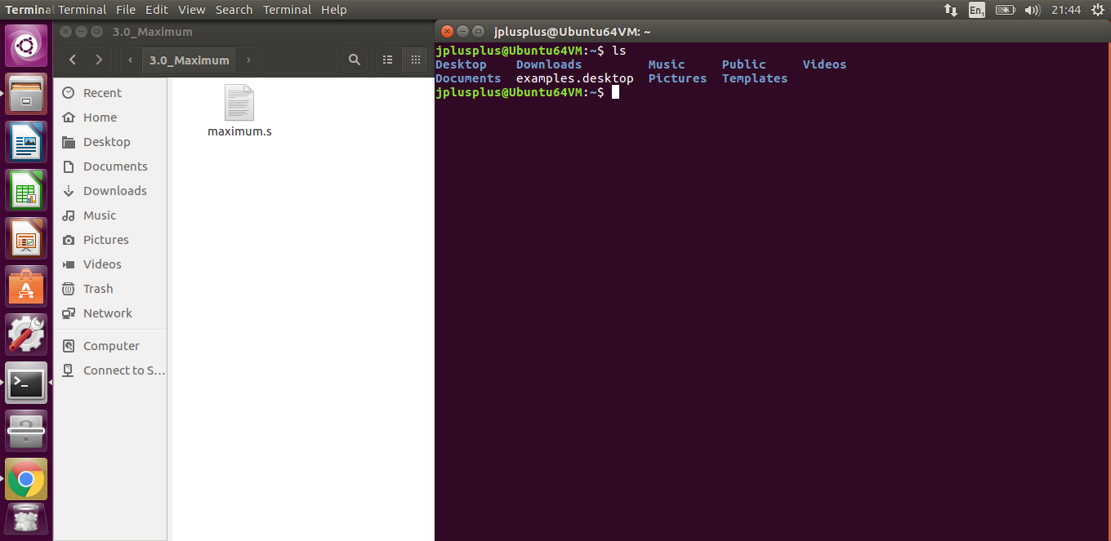
Maximum Navigate to maximum.s

Slide 37
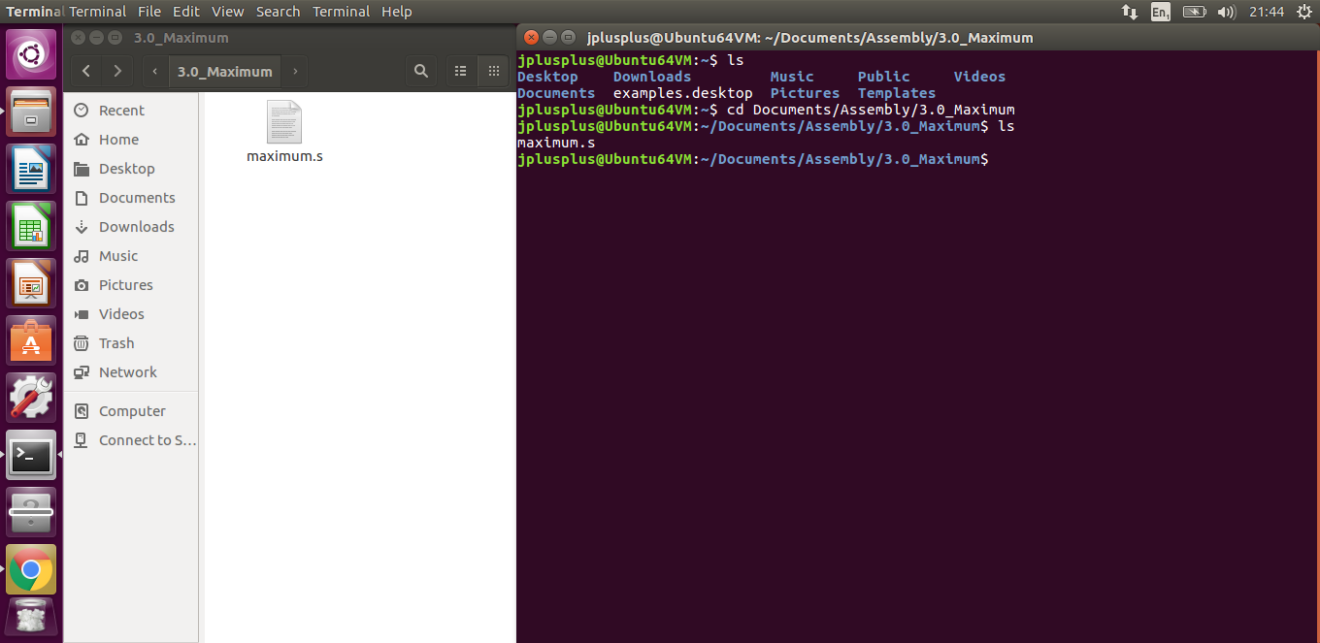
Maximum Navigate to maximum.s

Slide 38
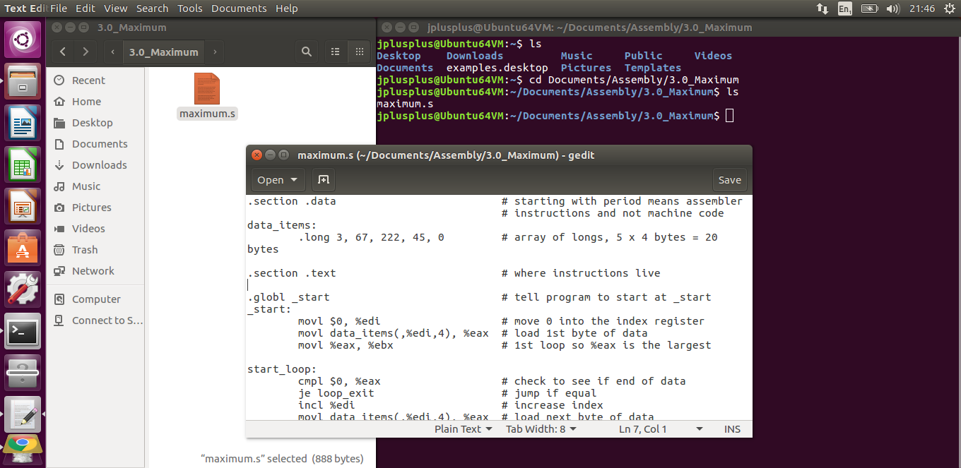
Maximum Navigate to maximum.s

Slide 39
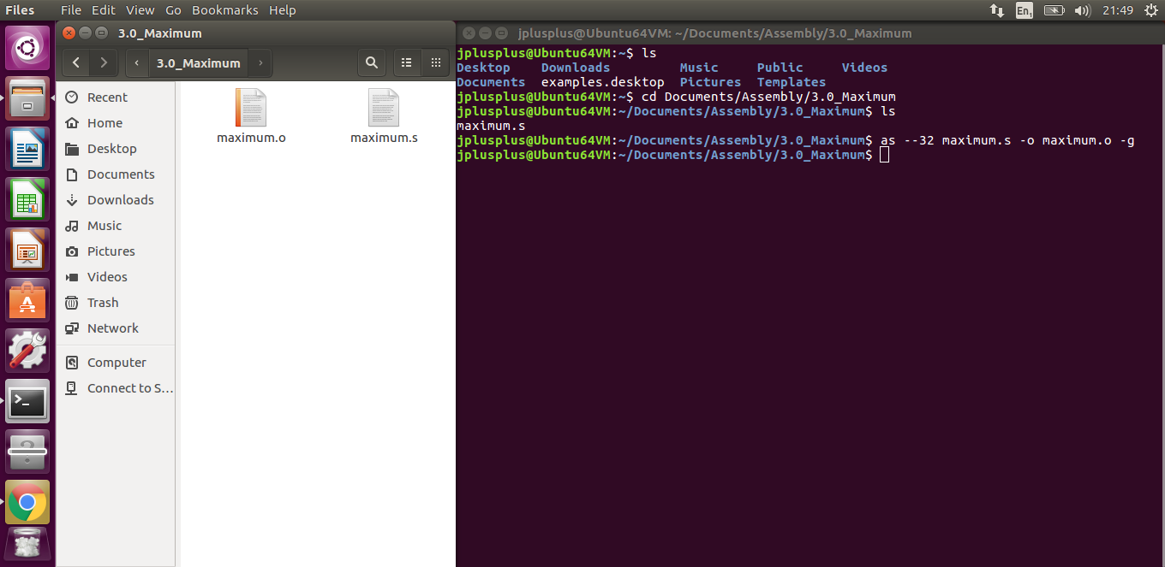
Maximum Assemble

Slide 40
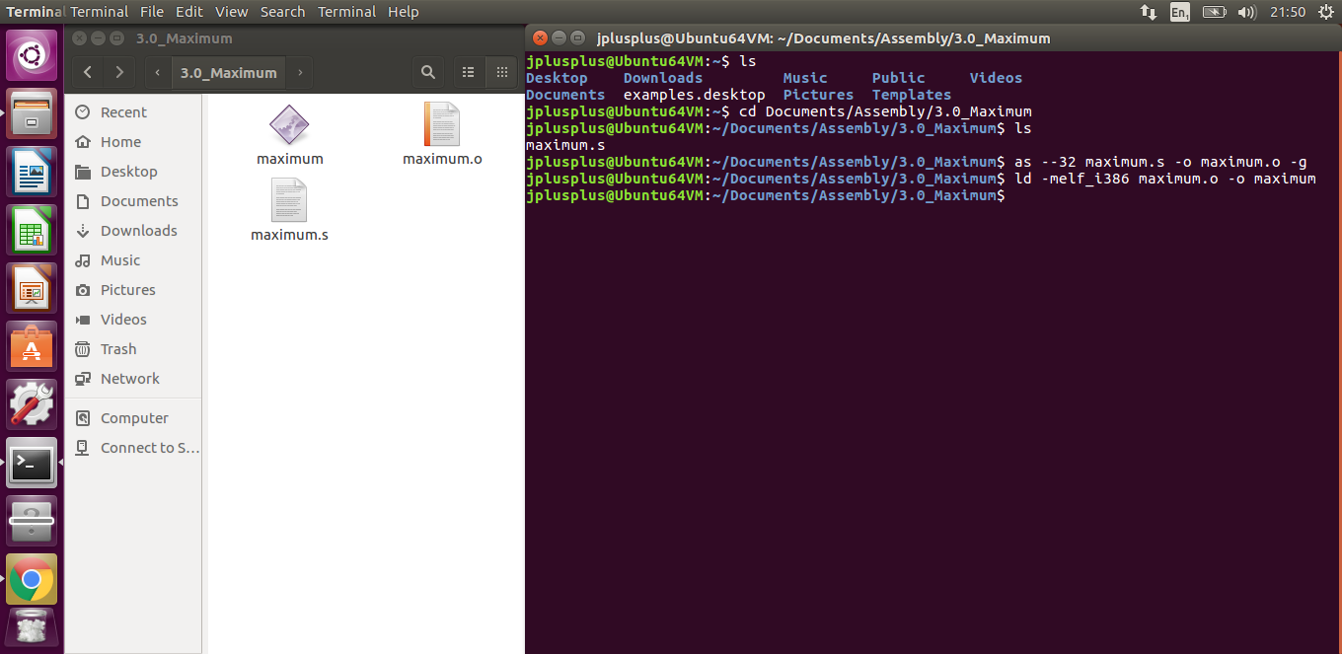
Maximum Link

Slide 41
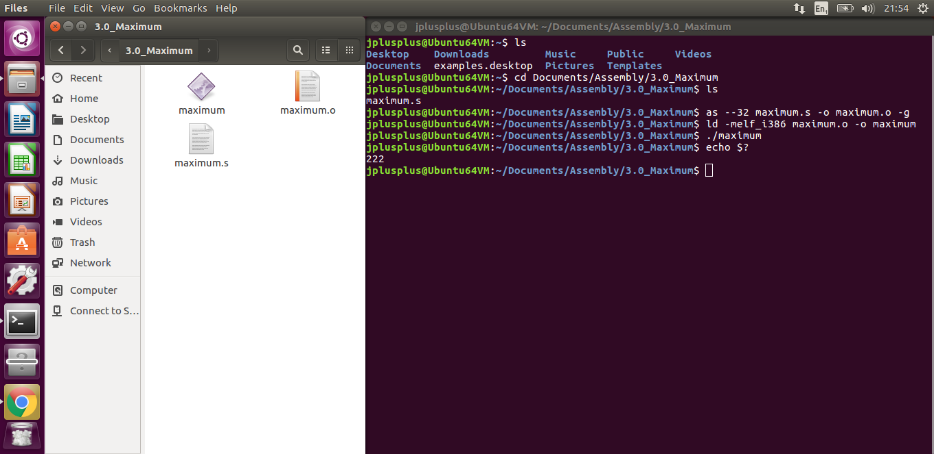
Maximum Run

Slide 42
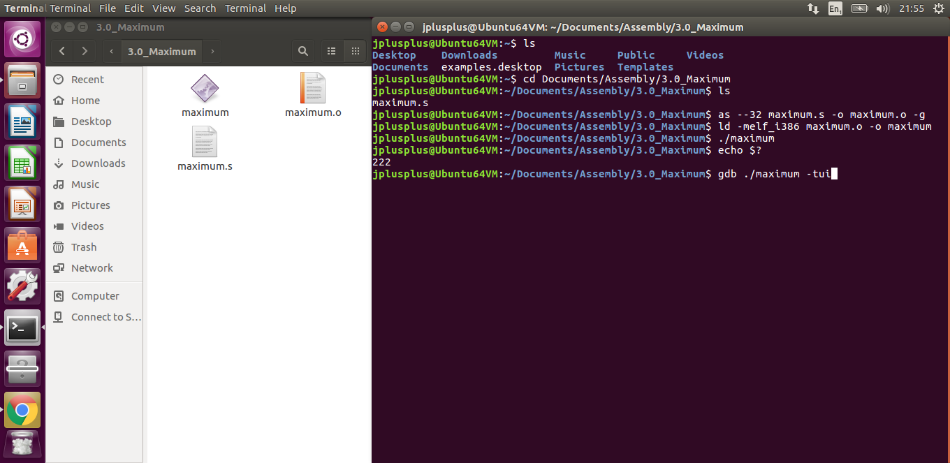
Maximum Gnu Debugger Text User Interface (gdbtui)

Slide 43
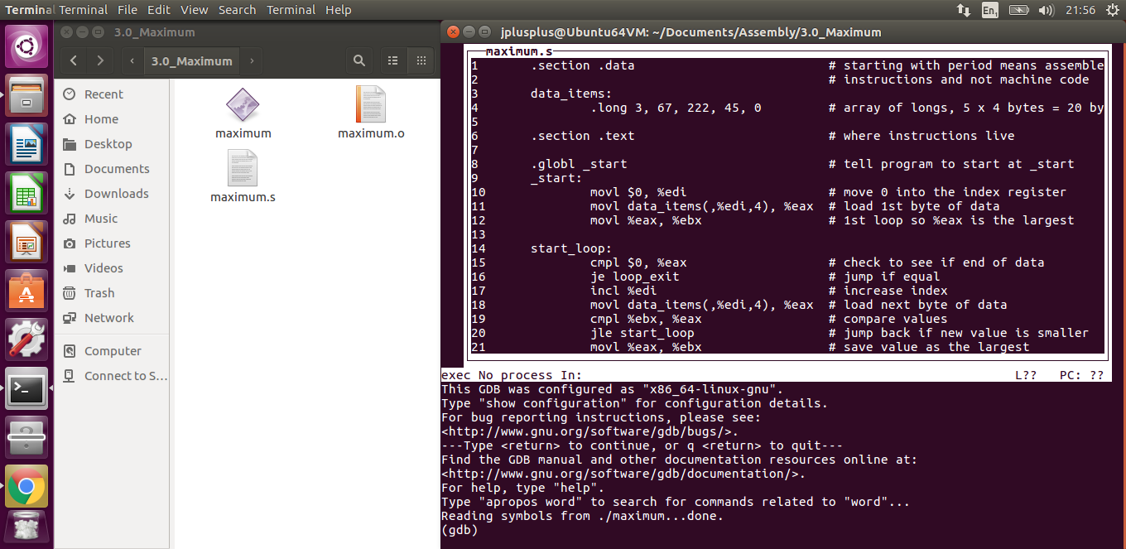
Maximum gdbtui

Slide 44
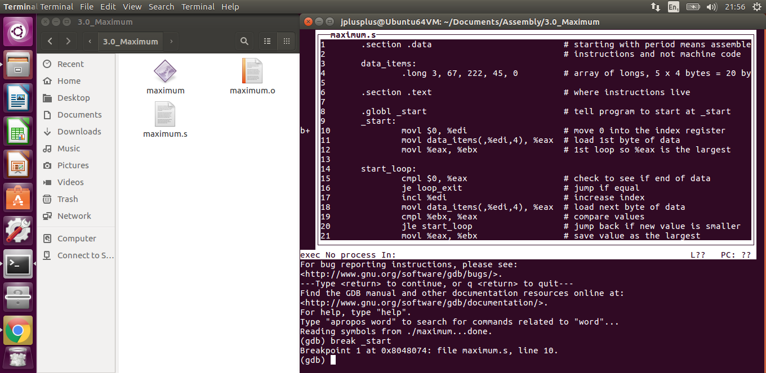
Maximum gdbtui: breakpoints

Slide 45
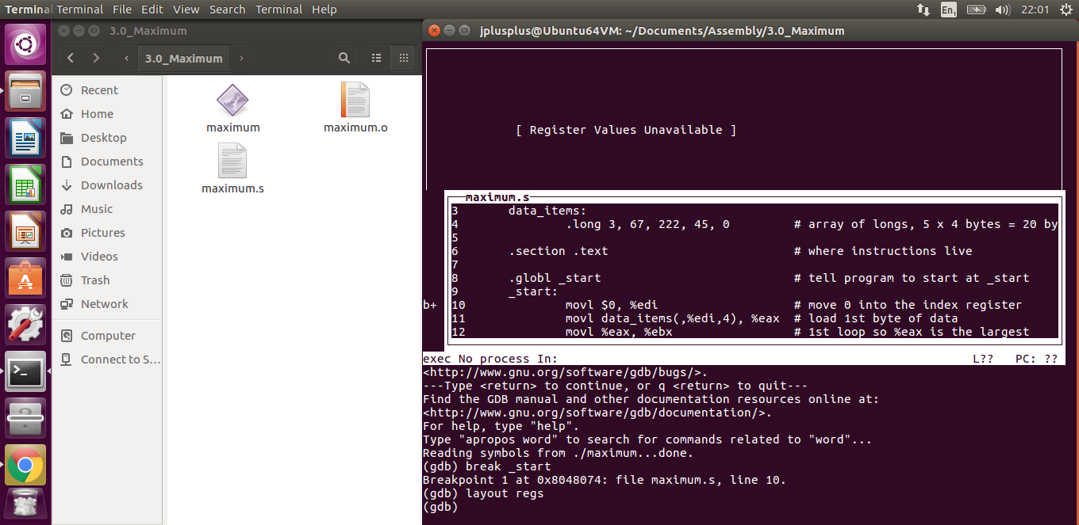
Maximum gdbtui: registers

Slide 46
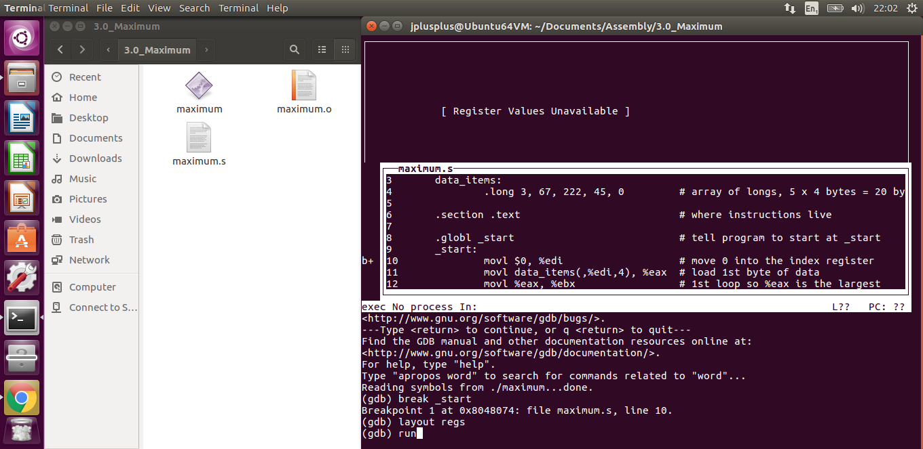
Maximum gdbtui: run

Slide 47
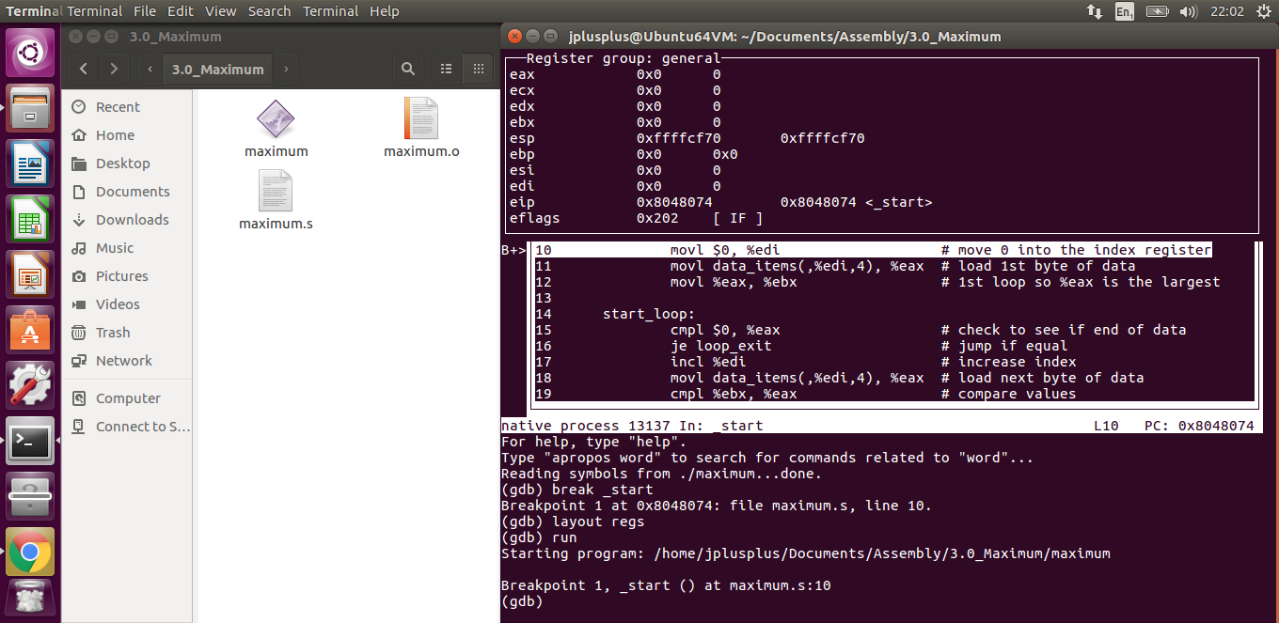
Maximum gdbtui: run

Slide 48
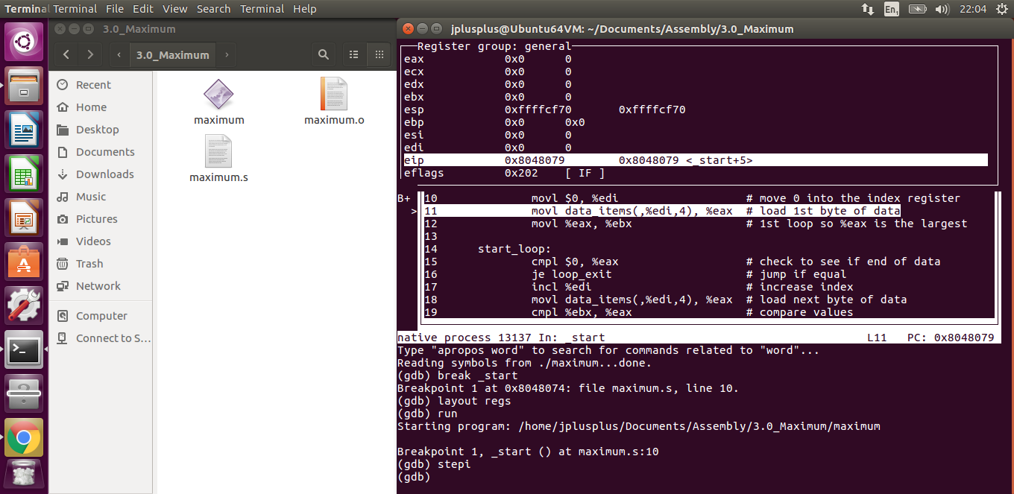
Maximum gdbtui: step into

Slide 49
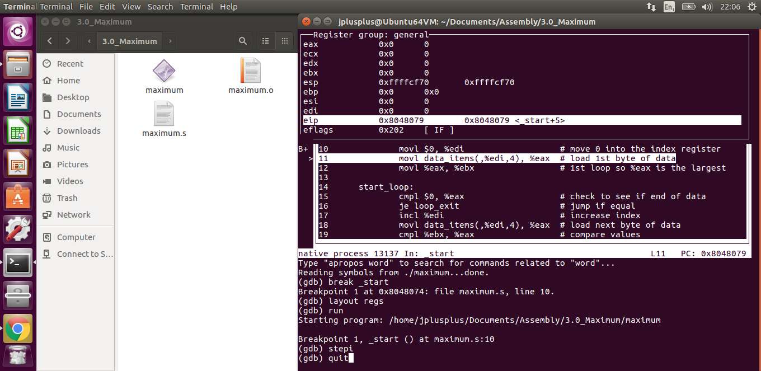
Maximum gdbtui: quit

Slide 50
Maximum gdbtui: quit

Slide 51

Maximum gdbtui: quit

Slide 52
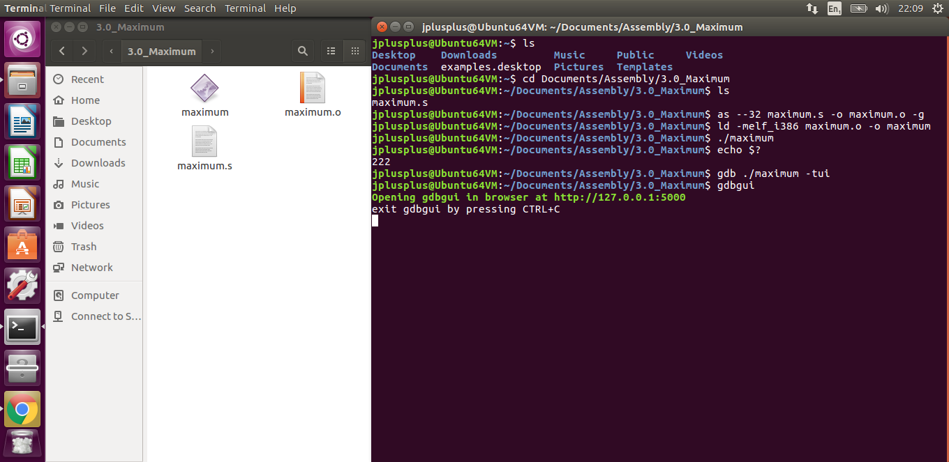
Maximum Gnu Debugger Graphical User Interface (gdbgui)

Slide 53
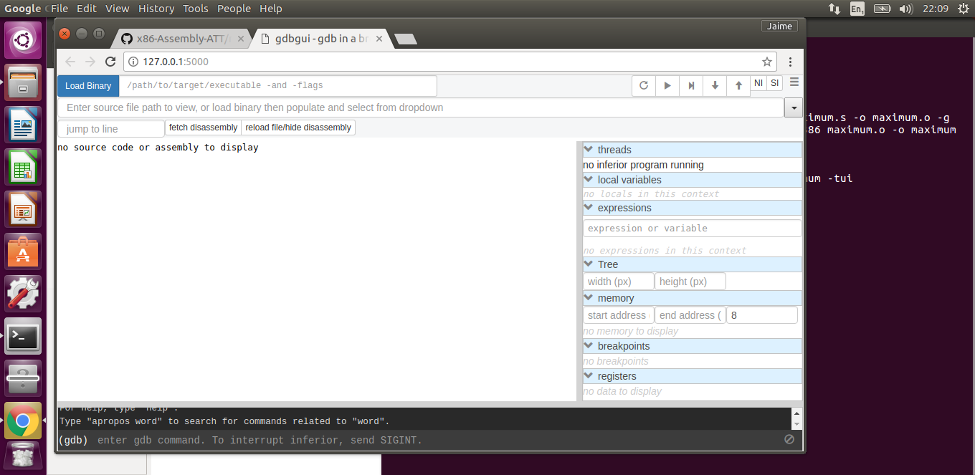
Maximum gdbgui

Slide 54
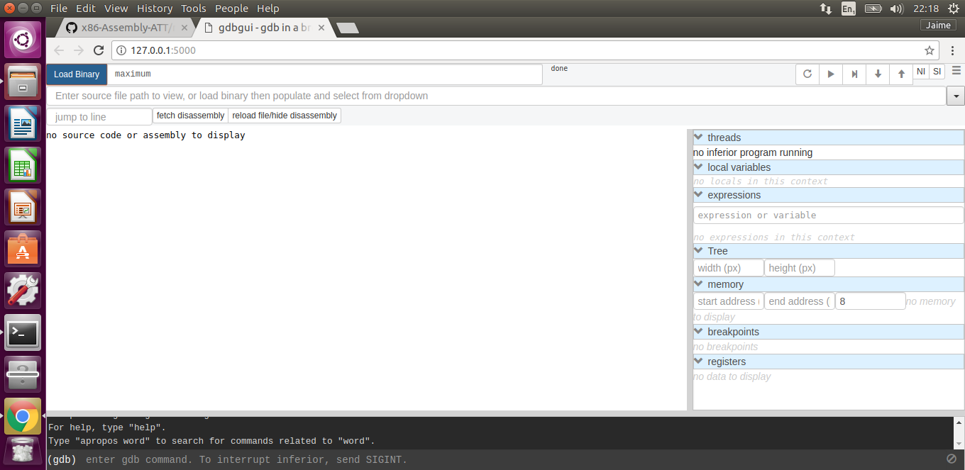
Maximum gdbgui: binary

Slide 55
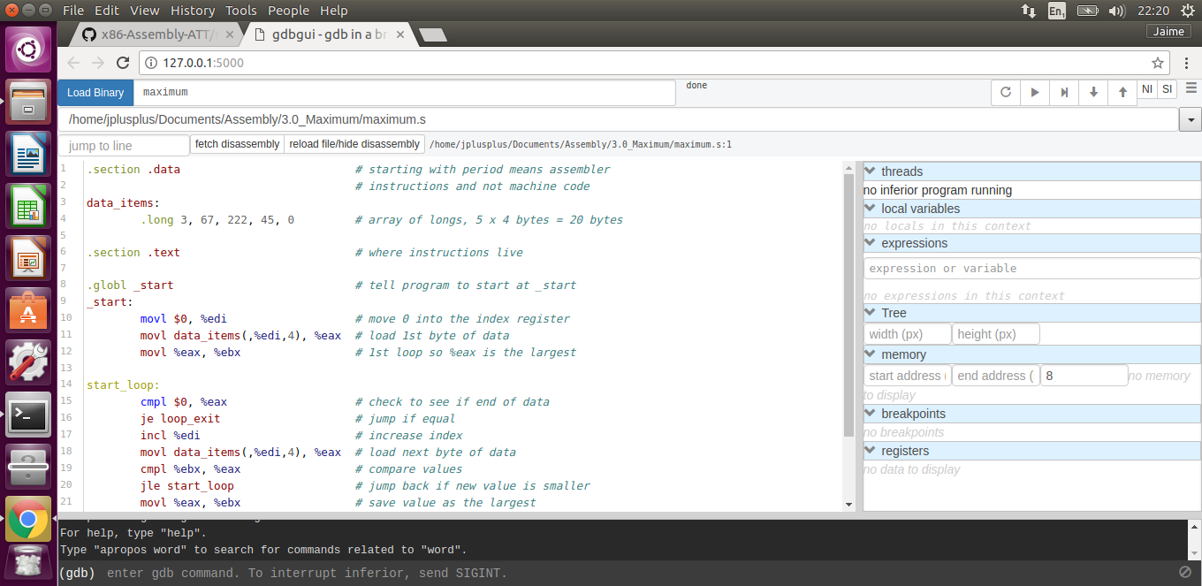
Maximum gdbgui: source file

Slide 56
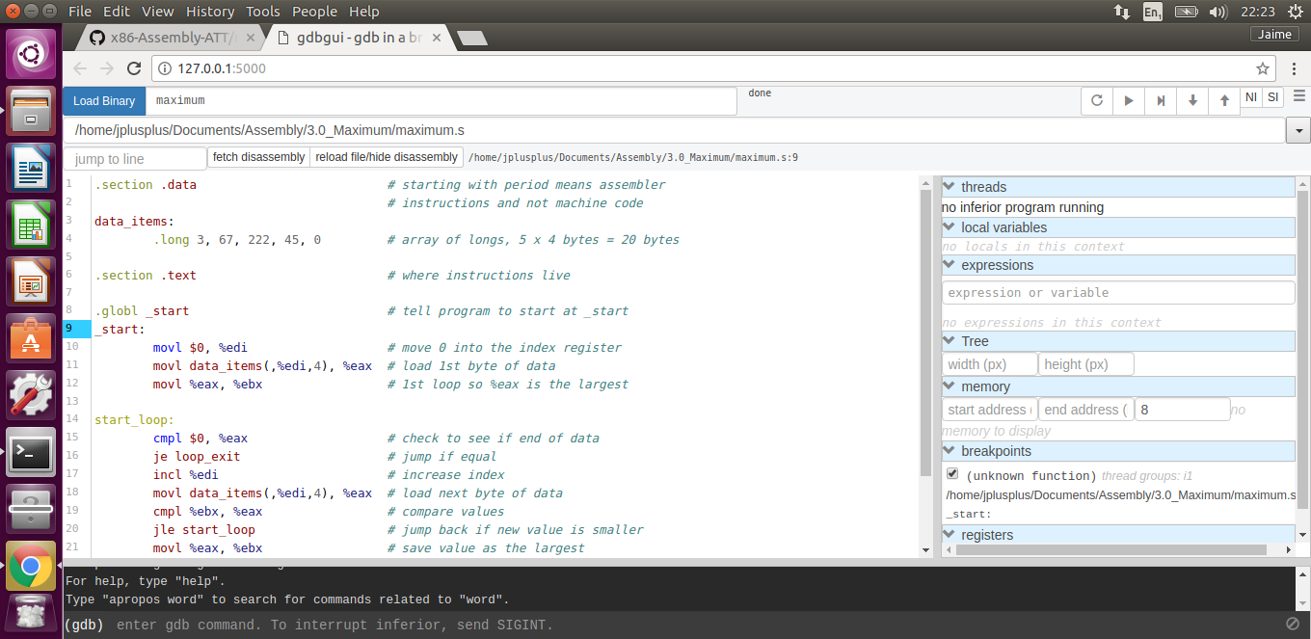
Maximum gdbgui: break points

Slide 57
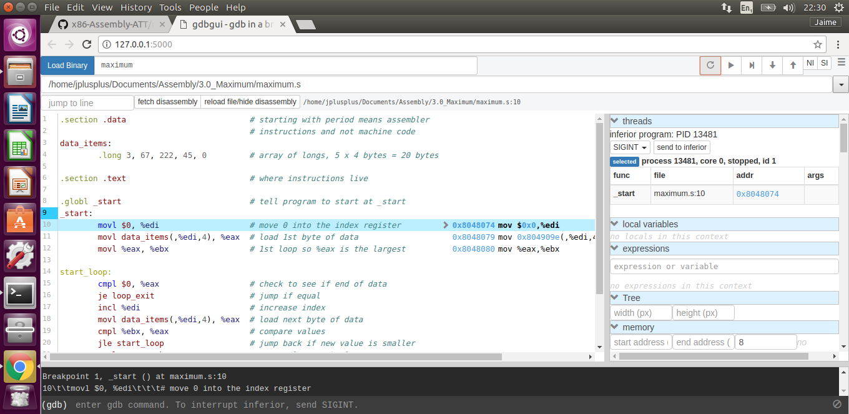
Maximum gdbgui: run

Slide 58
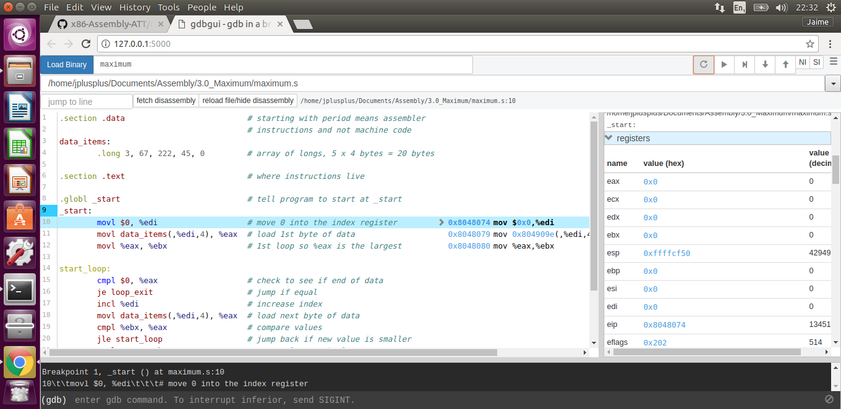
Maximum gdbgui: registers

Slide 59
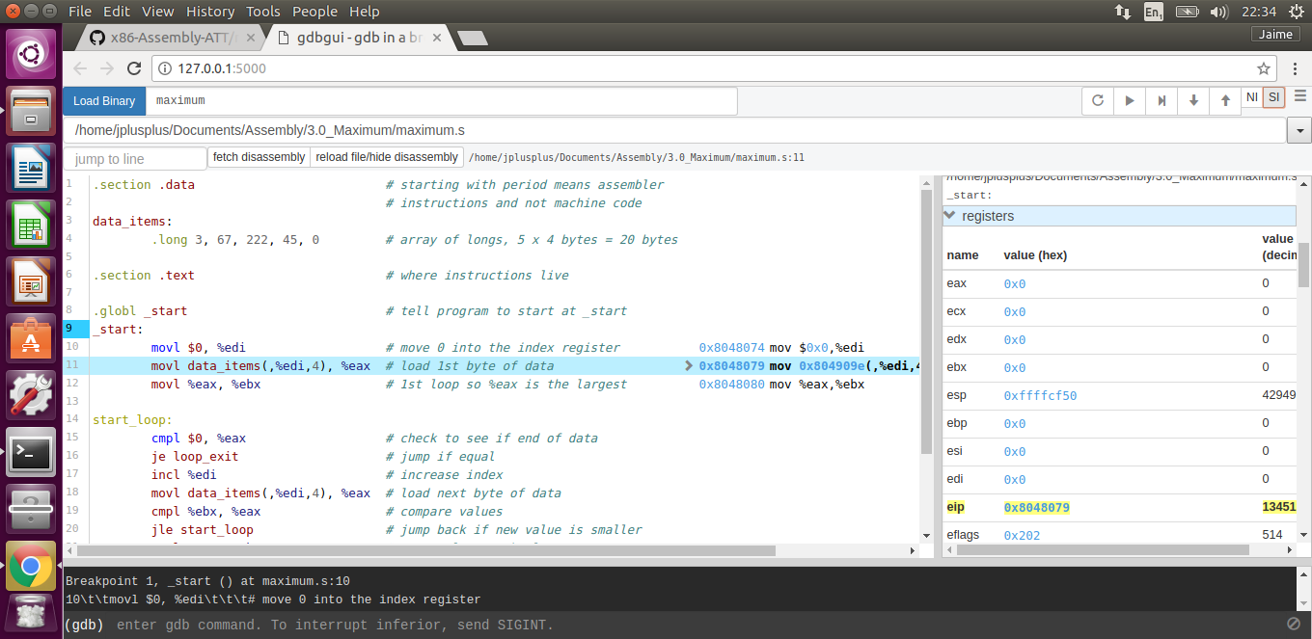
Maximum gdbgui: step into

